Slide 1
Mastering Product Design
Five Lessons I Wish I Knew Then

Slide 2
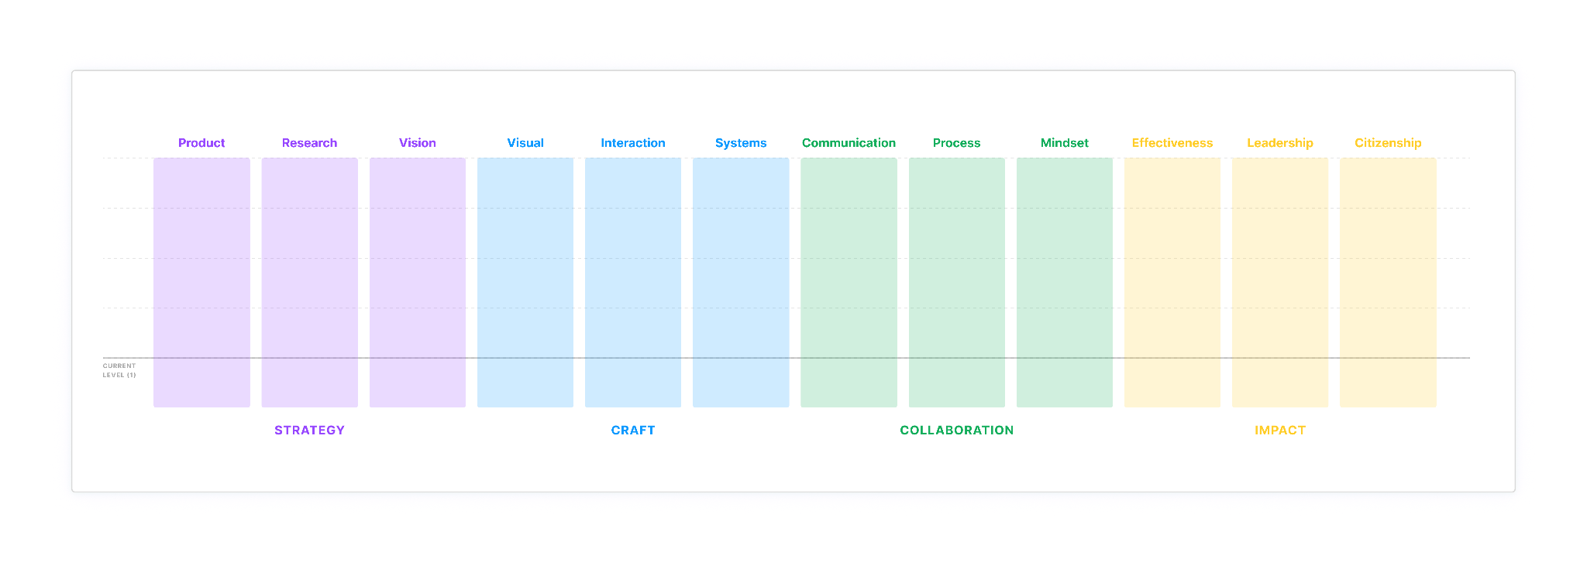
www.figma.com/blog/figma-design-team-career-levels

Slide 3
One
Know your principles

Slide 4
Where magic happens
Personal
Professional

Slide 5






Slide 6
Be kind
Everything is connected
Outcomes over outputs

Slide 7
Two
Alpha, Delta, and Zeta

Slide 8
Zeta
Design Vision
Future
Delta
Steps on the horizon to reach the future
Alpha
MVP
Now

Slide 9
Zeta
Future
Design Vision
Delta
Steps on the horizon to reach the future
Alpha
MVP
Possibilities & Unknowns
Constraints & Focus

Slide 10
Three
Design is storytelling

Slide 11


Slide 12
Tactics
Be a thoughtful host

Slide 13
Tactics
Be a thoughtful host
Design your presentation

Slide 14
Tactics
Be a thoughtful host
Design your presentation
Simplicity x visual

Slide 15
Tactics
Be a thoughtful host
Design your presentation
Simple and clear
Find your unique voice

Slide 16
Tactics
Be a thoughtful host
Design your presentation
Simple and clear
Find your unique voice
Rehearse and refine

Slide 17
Four
Befriend your inner critic

Slide 18


Slide 19
Wear your designer hat to critique your inner critic.
Acknowledge
Seek evidence
Take action
Or…Tell her/him/it to shut up… kindly.

Slide 20


Slide 21
Chatter Tools
Use distanced self talk
Imagine advising a friend
Broaden your perspective
Normalise your experience
Engage in Mental Time Travel
Write expressively
Perform a ritual

Slide 22
Five
Beginner’s mind

Slide 23

"In the beginner's mind, there are many possibilities;
in the expert's mind, there are few."
Image from shows.acast.com/what-you-will-learn/episodes/zen-mind-beginners-mind

Slide 24
A humble expert

Slide 25
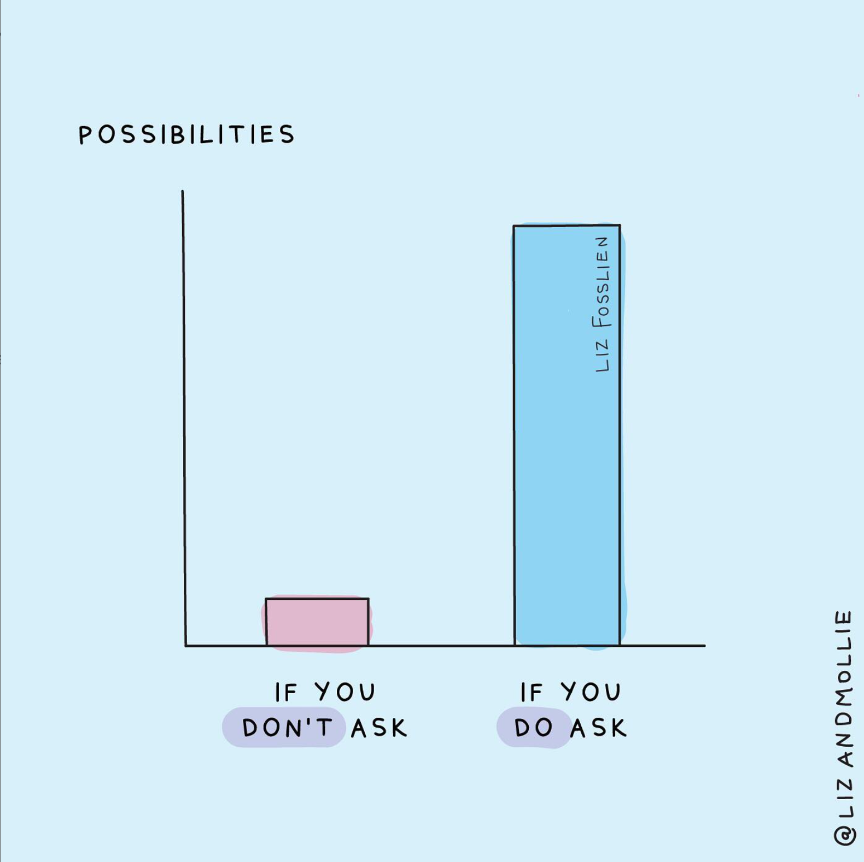
Ask questions
Why, why, and why?

Slide 26


Slide 27
Embrace experimentation and failure

Slide 28
How to embrace beginner’s mind
User research
Collaborate with diverse teams
Seek inspiration
Practice mindful listening

Slide 29
Recap
Know your principles
Alpha, Delta, and Zeta
Design is storytelling
Befriend your inner critic
Beginner’s mind

Slide 30
That’s it!

